Slide 1
ENPM808W: Data Science Assignment 1 Lightning Talks

Slide 2
Name- Pranav P. Jaipurkar UID- 115798120
Dataset -> IMDB data (2006-2016)
Link for Dataset -> https://www.kaggle.com/PromptCloudHQ/imdb-data
Attributes of dataset -> Rank, Title, Genre, Description, Director, Actors, Year, Runtime (Minutes), Rating, Votes, Revenue (Million Dollars) and Metascore.
There were 1000 movies in the dataset for analysis.
Rank | Title | Genre | Description | Director | Actors | Year | Runtime (Minutes) | Ratings | Votes | Revenue (Million Dollars) | Metascore

Slide 3
Major parameters that were considered for Data Analysis
Rank (min=1, max=1000)
Year (min=2006, max=2016)
Revenue (min=0, max=936.63)
Runtime (min=66, max=191)
Rating (min=1.9, max=9.0)
Votes (min=61, max=1791916)
Metascore (min=11, max=100)

Slide 4
Key Steps in my Data Analysis
Ignore the NA values.
Categorization of Votes, Ratings, Revenue, Metascore into 3-4 categories depending on their range.
Studying the behavior of any 2 variables between Rank, Revenue, Year, Runtime, Rating, Votes, Metascore in specific categories of each variables created above.

Slide 5
Major Conclusions from Data Analysis
As the Votes category varies from Low Votes to Highest Votes, the mean rating also increases.
There is a huge variation in rank in every Votes category.
As the revenue category varies from Low Revenue to High Revenue, the mean rating also increases.
As the revenue category increases, the rank category decreases the corresponding range of rank category also decreases.
As the metascore category varies from lowest metascore to high metascore, the mean rating increases.
A majority of movies have runtime between 90-130 minutes.
Revenue generated has a direct relationship with metascore for a majority of movies.
For majority of movies, an increase in runtime leads to an increase in ratings upto a certain value of runtime.

Slide 6
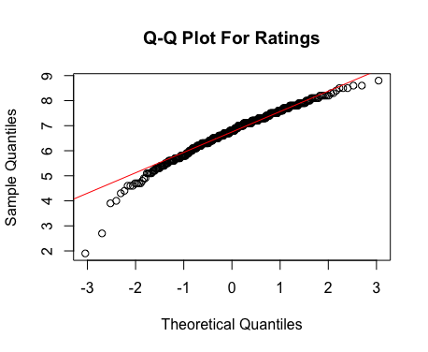
Q-Q Plot 1

Slide 7
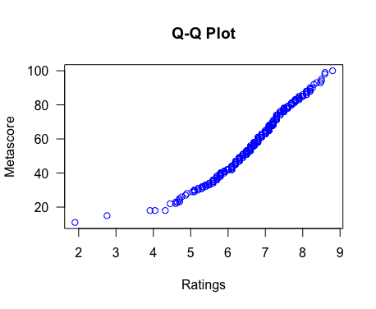
Q-Q Plot 2

Slide 8
THANK YOU !!!

